Slide 1
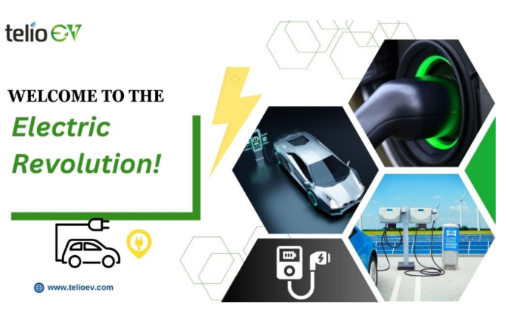
The Electric Vehicle Revolution :

Slide 2
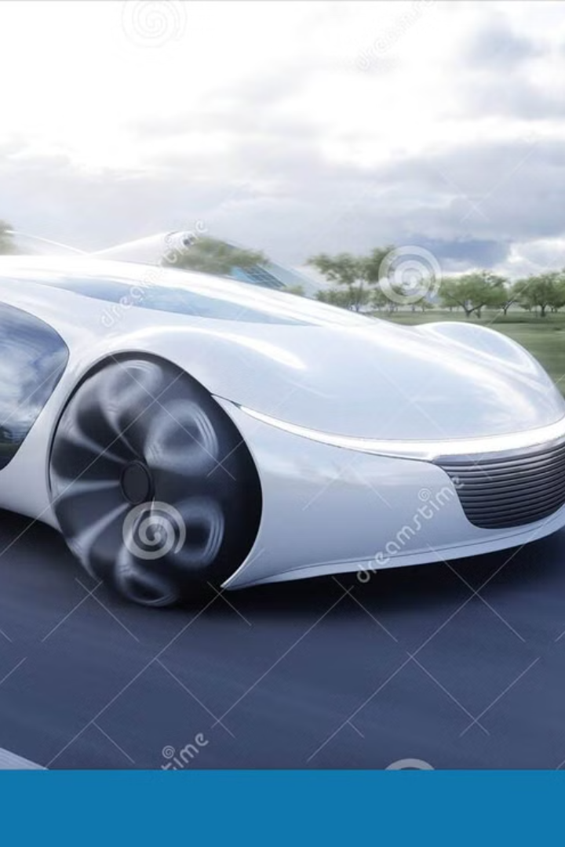
The Growth Of EVs
The electric vehicle market is booming. Global EV sales reached 10.5 million in 2023, a 35% increase from 2022. Market share is expected to reach 18% globally by the end of 2024. EVs are projected to reach 50% of all new car sales by 2030.
India aims for 30% EV adoption by 2030 as part of its clean energy initiative.

Slide 3
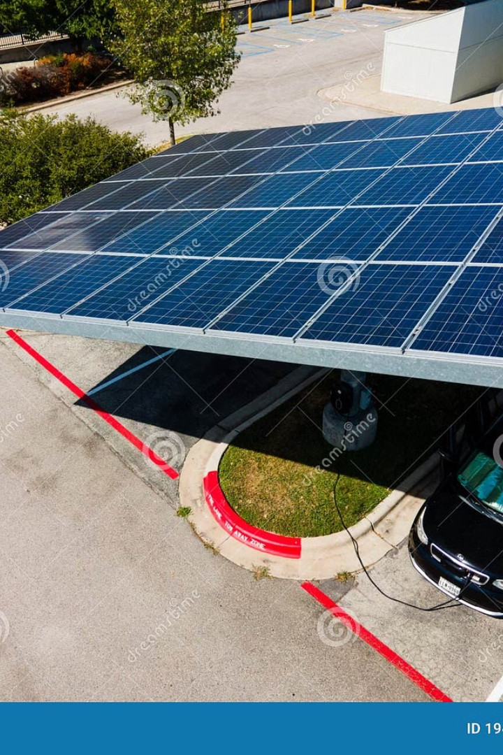
Environmental Benefits of EVs
Zero Emissions
One of the biggest advantages of EVs is that they produce zero tailpipe emissions.
Unlike gasoline or diesel vehicles, which release harmful gases like carbon monoxide and
nitrogen oxides, EVs help reduce local air pollution, making our cities cleaner.
Lower Carbon Footprint
EVs have a significantly lower carbon footprint than traditional gasoline vehicles. Depending on the energy source used to charge them, EVs produce 60-80% fewer emissions. If powered by renewable energy like solar or wind, they can be almost completely carbon-neutral.
Reduced Lifecycle Emissions
Lifecycle emissions (manufacturing, operation, and disposal) are 30-50% lower.
Less Noise Pollution
EVs are much quieter than conventional vehicles.
This not only makes roads more peaceful but also reduces noise-related health -
issues, improving the quality of life in urban areas.

Slide 4
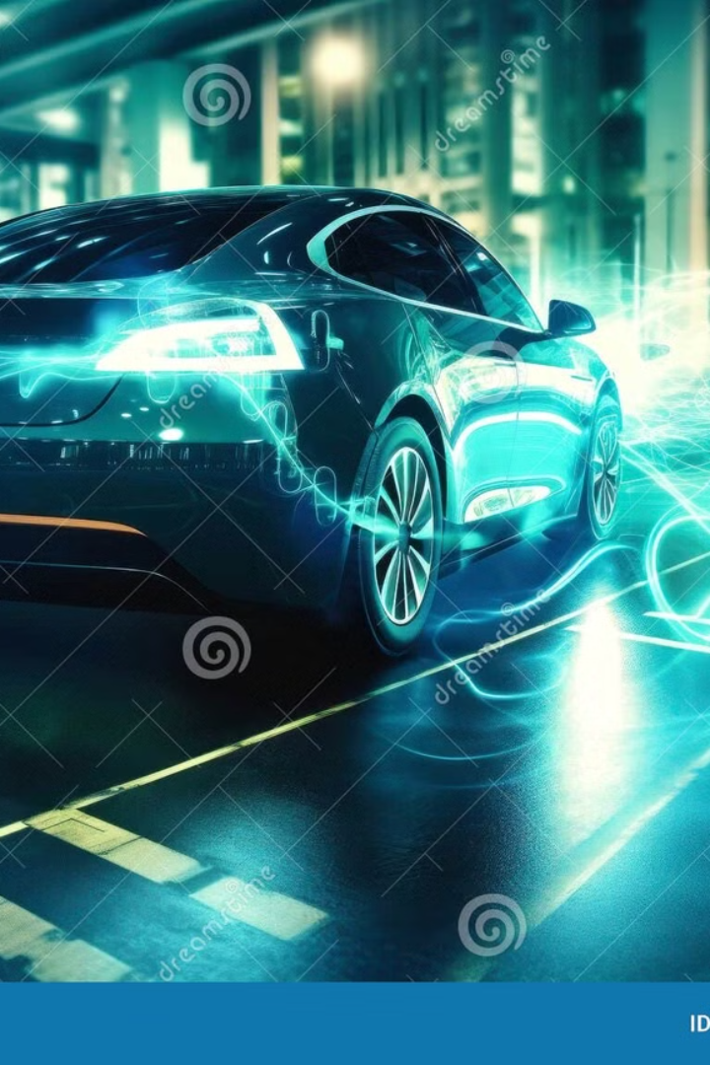
Economic Advantages of EVs
Lower Running Cost
Electricity is much cheaper than gasoline. On average, an EV owner saves between $800 and $1,200 per year on fuel costs compared to a gasoline car.
Reduced Maintenance
EVs have fewer moving parts than gasoline cars. They don’t require oil changes, and their brakes last longer due to regenerative braking. This results in up to 30% lower maintenance costs.
Government Incentives
Many governments are providing subsidies, tax breaks, and rebates to encourage EV adoption. For example, some countries offer up to $7,500 in tax credits for purchasing an EV.
Job Creation
The EV industry is generating millions of jobs in battery production, charging infrastructure, and vehicle servicing. Countries investing in EV technology are also boosting their local economies.

Slide 5
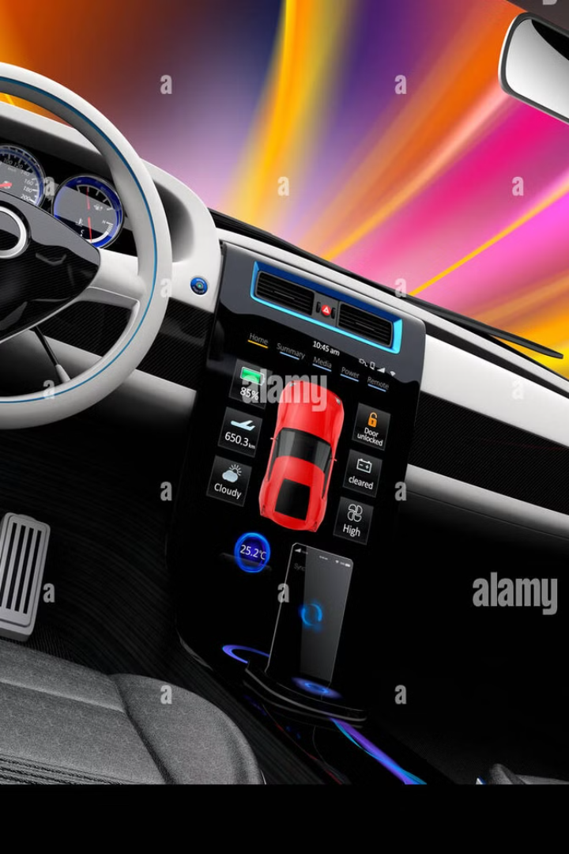
Technological Advancements in EVs
Battery Technology
Battery technology is improving rapidly. In the last decade, lithium-ion batteries have seen a 50% increase in energy density, making EVs more efficient and increasing their driving range.
Charging Infrastructure
Fast-charging stations are being developed worldwide. High-power chargers (350kW) can now add up to 200 miles of range in just 30 minutes, making long-distance travel easier.
Autonomous Driving
Many EVs now come equipped with Advanced Driver Assistance Systems (ADAS), which include features like lane-keeping assistance, adaptive cruise control, and even self-driving capabilities.
Over-the-Air Updates
Unlike traditional cars, EVs can receive software updates remotely. This means that manufacturers can improve battery efficiency, add new features, and enhance safety without requiring a visit to the dealership.

Slide 6
Market Trends in the EV Industry
Market Leaders
Popular Models
Tesla currently dominates the EV market with a 20% global
market share. However, other big automakers
like General Motors, Ford, and Volkswagen are increasing
their EV production to compete.
Some of the most popular EVs today include
the Tesla Model Y, Ford F-150 Lightning
(an electric truck), and Chevrolet Bolt, which
offer impressive range and performance.
New entrants:
Startups like Rivian, Lucid Motors, and Nio are
bringing innovation to the EV space, introducing
advanced battery technology and luxury electric models.

Slide 7
Charging Infrastructure for EVs
Public Stations
Government Investment
As EV adoption grows, governments and private companies are increasing the number of public charging stations, making it easier for EV owners to charge their vehicles.
The U.S. government has announced a $7.5 billion investment in EV charging networks to ensure widespread accessibility.
Wireless Charging
Home Charging
New technologies are emerging that allow EVs to charge wirelessly while parked or even while driving on specially designed roads.
Most EV owners charge their vehicles at home using Level 2 chargers, which can fully recharge a car overnight.

Slide 8
Challenges and Obstacles for EVs
High Upfront Costs
EVs are generally more expensive than gasoline cars, mainly due to battery costs.
However, prices are gradually decreasing as technology improves.
Range Anxiety
Some consumers worry about running out of battery before reaching a charging station.
To address this, automakers are increasing battery capacity and expanding charging networks.
Charging Time
Unlike gasoline cars that can be refueled in minutes, EVs take longer to charge.
However, advancements in fast-charging technology are helping to reduce this issue.

Slide 9
The Future of EVs: Innovation
Solid-State Batteries
Next-generation solid-state batteries promise higher energy density, faster charging, and improved safety
compared to current lithium-ion batteries.
Battery Swapping
Instead of waiting for a battery to charge, battery-swapping stations allow drivers to
replace a depleted battery with a fully charged one in minutes.
Vehicle-to-Grid (V2G)
EVs can act as mobile power sources, supplying electricity back to the grid when needed.
This technology can help balance energy demand and reduce power outages.

Slide 10
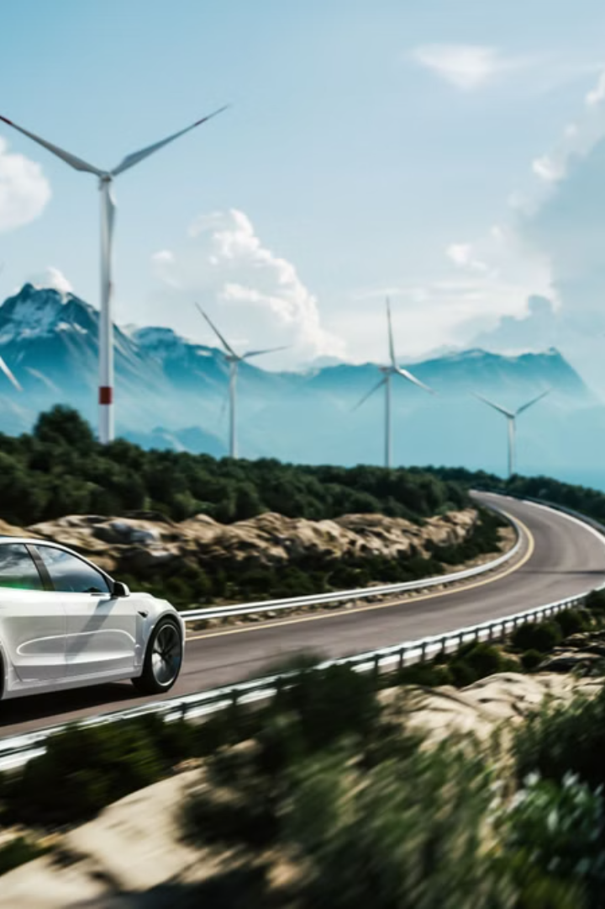
Conclusion: Accelerating EV Transition
60-80%
$7.5B
Lower carbon footprint compared to gasoline cars.
US government investment in EV charging
To sum up, EVs provide significant environmental and economic benefits, and their market is growing rapidly. While there are challenges like charging infrastructure and battery costs, continuous innovations are helping overcome these obstacles.
Governments and industries are investing heavily in EV technology. As battery efficiency improves and charging networks expand, EV adoption will continue to rise
The future of mobility is electric, and we are witnessing a revolutionary shift in the way we travel. Thank you for your attention.

